Slide 1
Digitalisation in Moldovan higher education: Status Quo and future directions
Sanda Caracentev (AUM, Moldova)
1 December 2023
IEED, Paris

Slide 2
Overview
Republic of Moldova on course to digital innovation
- legislation, strategies, collaborations → adopted
Aligns with EU initiatives
- consultations, funding, implementation
Education sector:
- targeting mostly schools, HE lagging behind
- provisions to improve HE being made

Slide 3
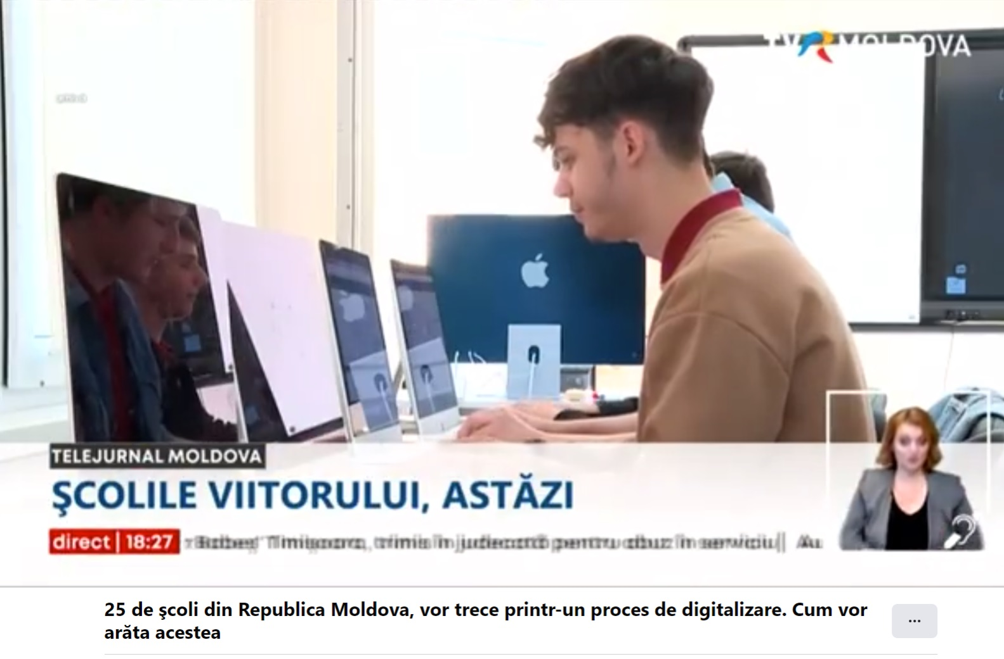
Moldova in the European context
Republic of Moldova steps:
Agency for quality in higher education
EU partnerships
Completed programmes:
- Education Development Strategy 2014-2020
- Digital Moldova 2020
- initiatives completed and planned to digitalise schools across the country in sync with European priority areas in digital development → EU support
More schools planned to be digitalised in a next phase
Source: TVR Moldova (30 Nov 2022)

Slide 4
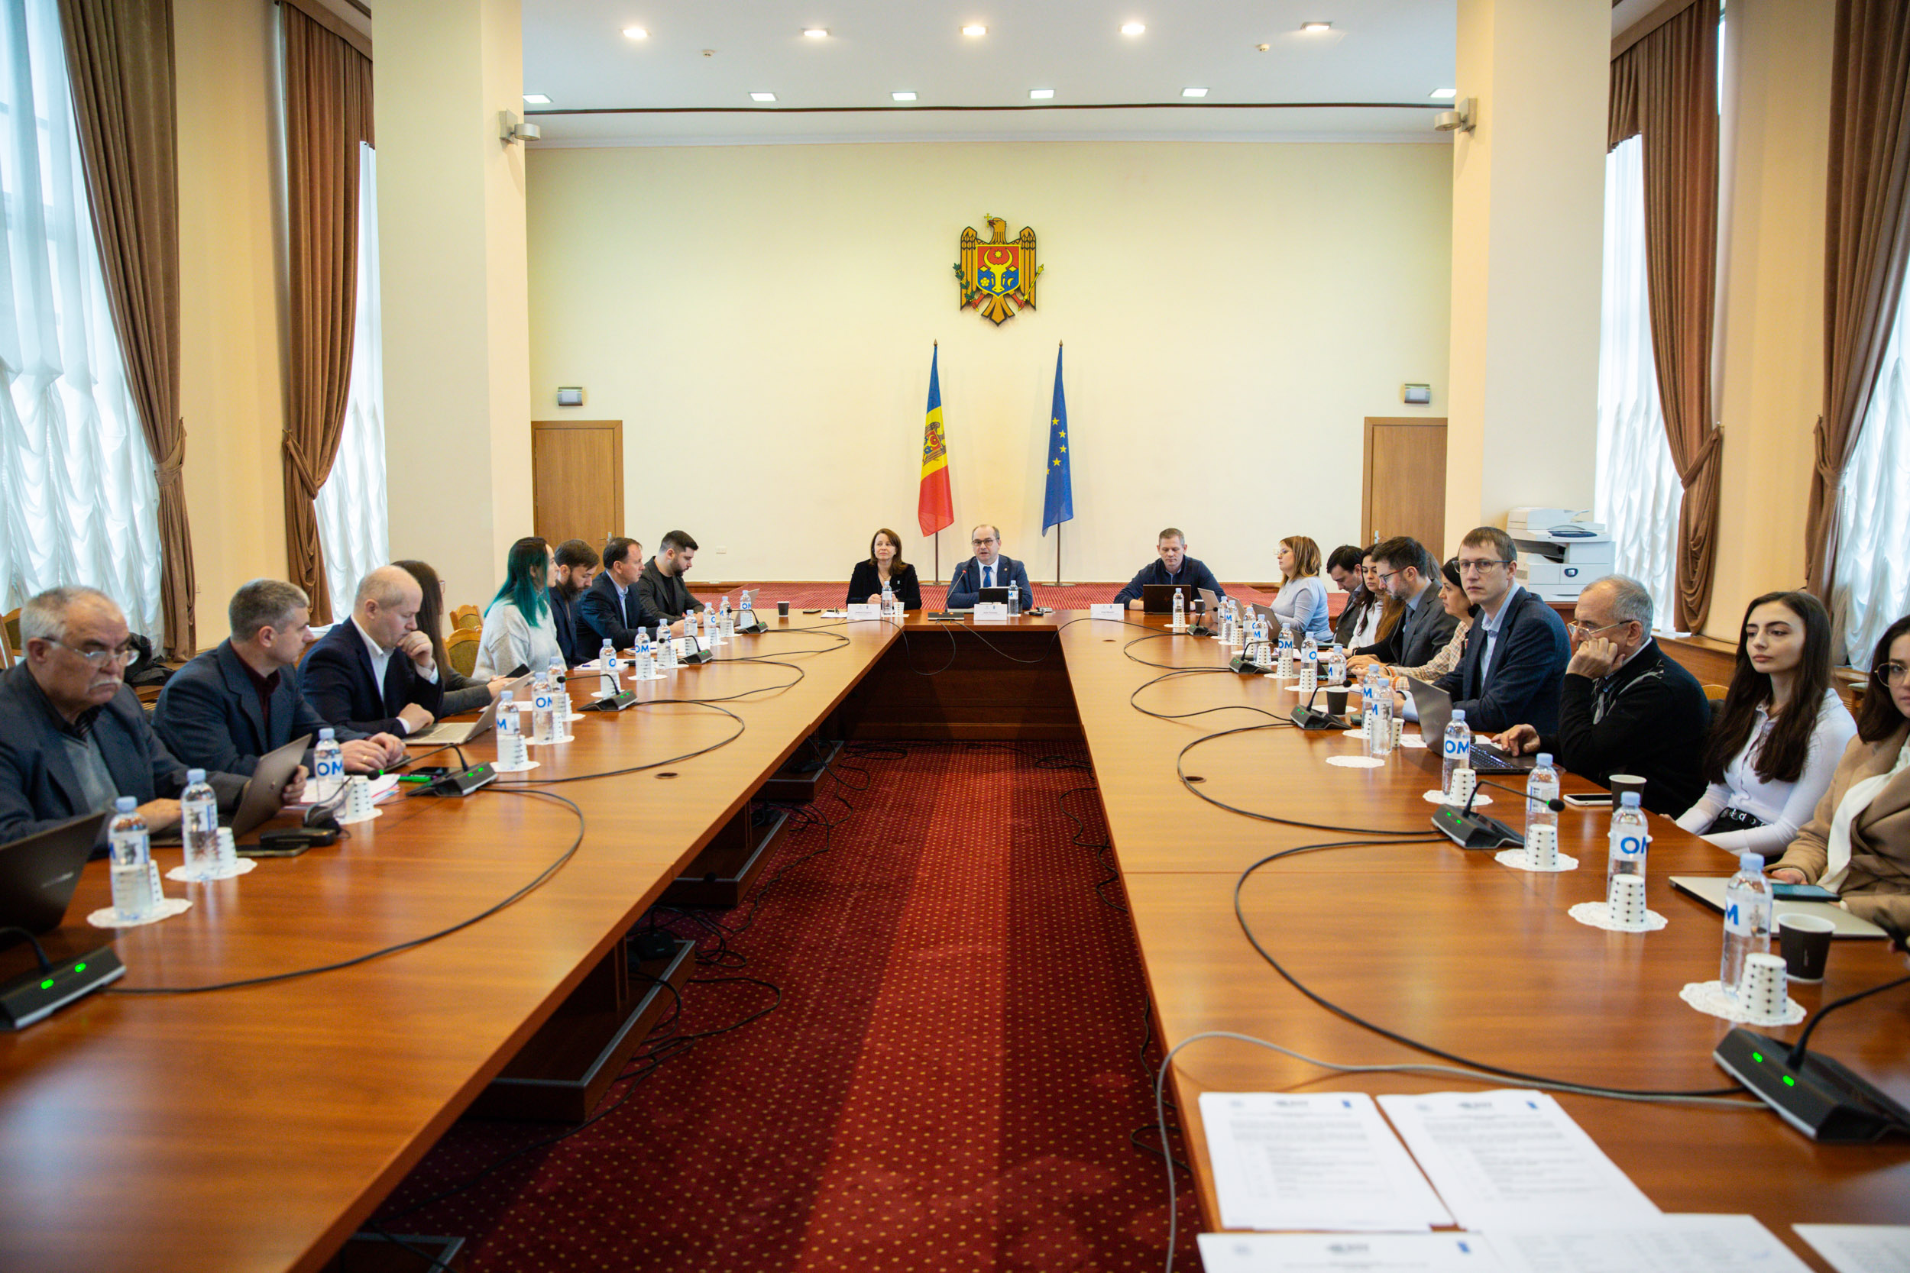
Moldova in the European context
EU4Digital:
Strategy for Digital Transformation of the Republic of Moldova
2023-2027 →to be revised annually
New inclusive technologies, infrastructures, digital upskilling, support for innovation
Education is one of target areas, higher education only mentioned
Public consultation on the Strategy for Digital Transformation
Source: EU4Digital (2023)

Slide 5
Current developments
Republic of Moldova - legislation (2023):
National Strategy for the Development of Education 2030
All levels – including HE
Digitalisation is one of the priorities
Initiatives:
The Higher Education Project (ongoing) – implemented by the Ministry for Education and Research, funded by the World Bank
New technologies in higher education – curricula, labs, equipment
Evaluations/publications:
Digital Ecosystem Assessment (2022) – USAID – while HE digitalisation is a priority, there is need for more support
Natalia Apetrii (2022) on implementing AI as HE learning tool

Slide 6
Status Quo: Higher education
Focus:
Digitalising schools first
HE – focus on STEM and improving IT courses at universities
Facts (ITU/UNDP 2021):
- 18 HE institutions teaching ICT courses
- Women severely underrepresented in ICT education → 4.6% of girls in STEM HE subjects
- Women underrepresented in ICT jobs (31%) and digital professions (19%)
- Evidence of digital tools already being used in teaching on all education levels

Slide 7
Status Quo: Research
Research and HE:
Main research institution: Academy of Sciences (Chisinau)
lack of integrated research components in HE institutions across the country
- Few researchers in engineering and IT → 14% in 2019 (ITU/UNDP 2021)
- Focus on integrating STEM knowledge in academia through interdisciplinary collaboration / projects
- Lack of research on the impact of digitalisation on vulnerable users
- Social sciences underrepresented / overlooked
- Insufficient provisions for open data sharing and publication → lack of guidance for researchers and students

Slide 8
Directions: Higher education
Policy directions
Develop HE policies regarding disinformation
Forge internal collaborations between HE institutions in STEM and other disciplines, and the Academy of Sciences
Tackle high-level plagiarism (postgraduate and academic publications)
HE institutions regulations:
Develop new curricula, in line with current developments
Update internal policies on research and data sharing
Update assessment strategies → AI considerations

Slide 9
Directions: Research
Focus on creating shared digital research area with Romania / EU
Government priorities:
Fulfilling the Plan for Research, Development and Innovation 2022-2027
Developing research infrastructures
Providing and improving funding for scientific events and publications
Better evaluation and accreditation actions for HE and research institutions

Slide 10
Conclusions
Legislative and strategic efforts to improve digital literacy and integrate new technologies into HE and research
Aligned with EU priorities
Regional and EU collaborations and partnerships
Focus on STEM and IT
Most initiatives and projects fulfilled in schools, but not HE
Policies remain largely vague and do not address specific issues in every discipline
Lack of support for social sciences

